Slide 1


High Volume Journey Digitalization
Biosmart Journey
Fubu Tribe
February 2023

Slide 2
HVJD Overview
The aim of this delivery is to have a Digital platform (MTN online portal / my MTN app) where Customers can start request for SIM related services and visit the store to complete the transaction.
System will generate a tracking ID to the customer on successfully filling the form- which will be presented to the agent in-store.
The customer will be able to initiate SIM process for SIM Swap, MNP and SIM Registration
Delivery includes:
Ability to capture selfie directly from device camera
Liveliness detector for live image capture
Generate transaction ID for successful submission. Transaction ID expiration date is set to 72 hours (configurable)
Unique transaction ID based on Service type: SIM Swap will have SWAP0001, MNP- MNP001 and SIM Reg will have SREG0001
NIN Validation before processing records
Ability book appoint via MTN Appointment Scheduler-Customer to see a URL to the MTN Appointment Scheduler

Slide 3
AS-IS Journey

Slide 4
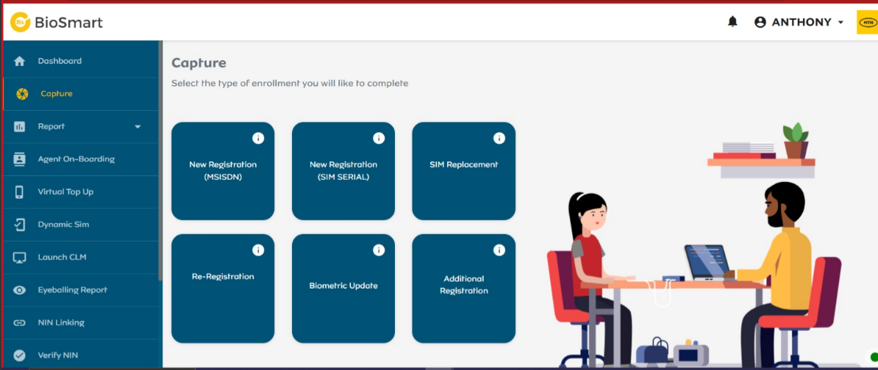

Slide 5
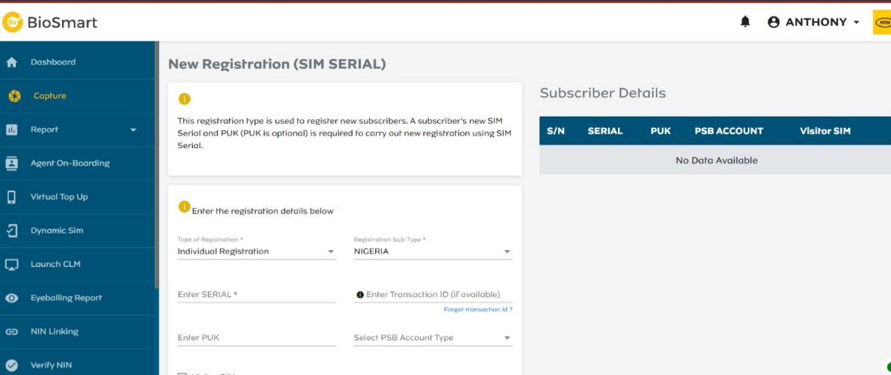

Slide 6
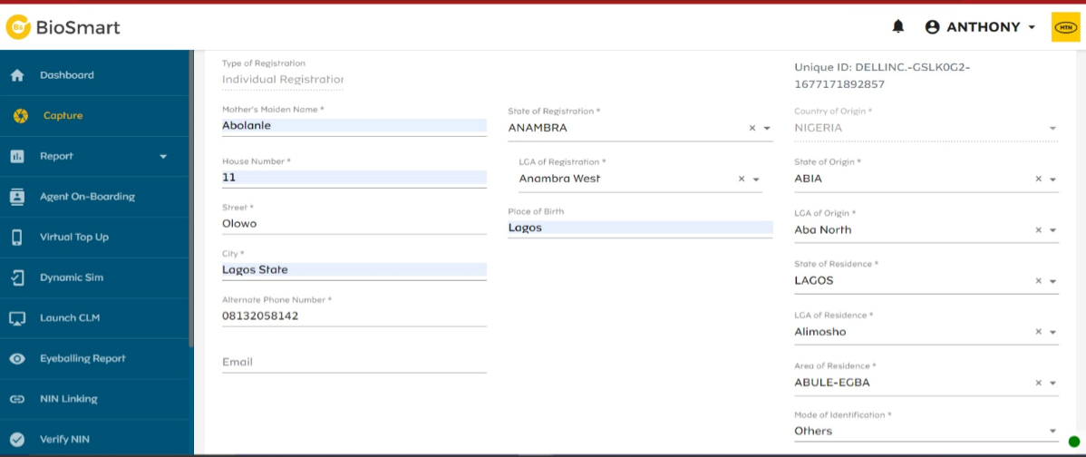
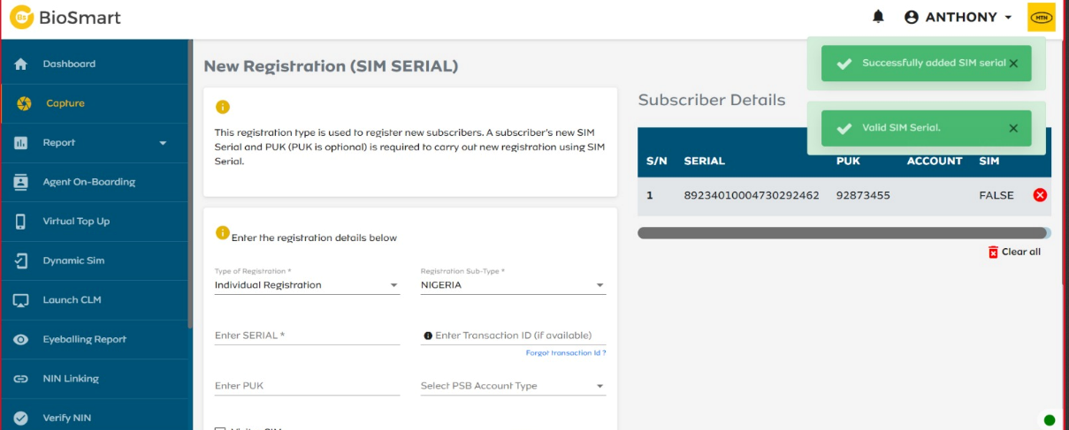

Slide 7
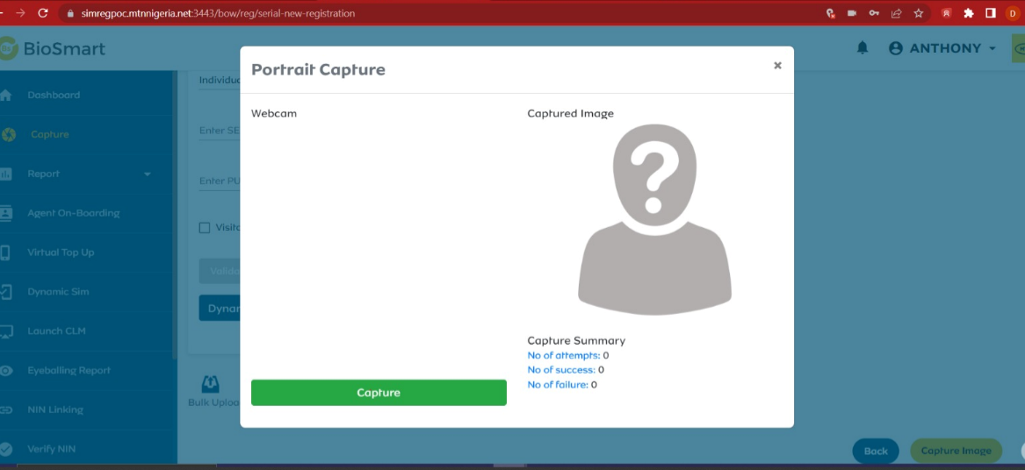
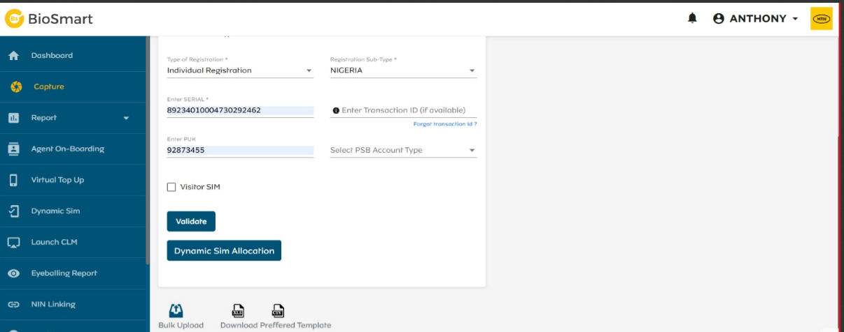

Slide 8
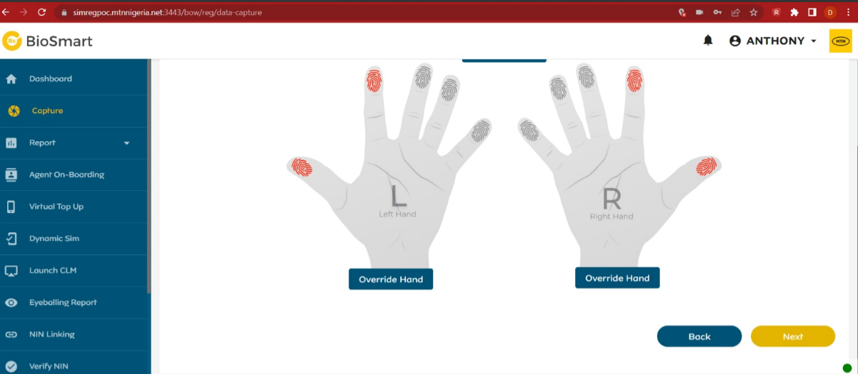
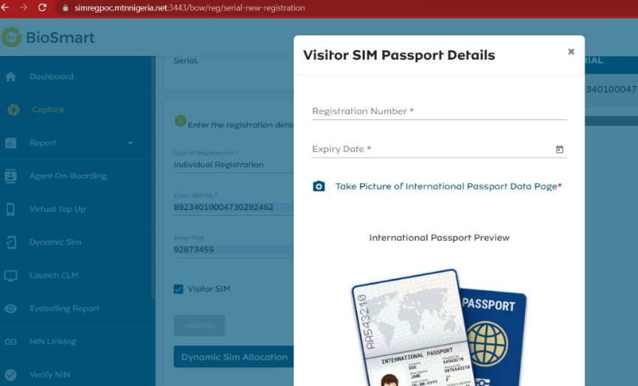

Slide 9
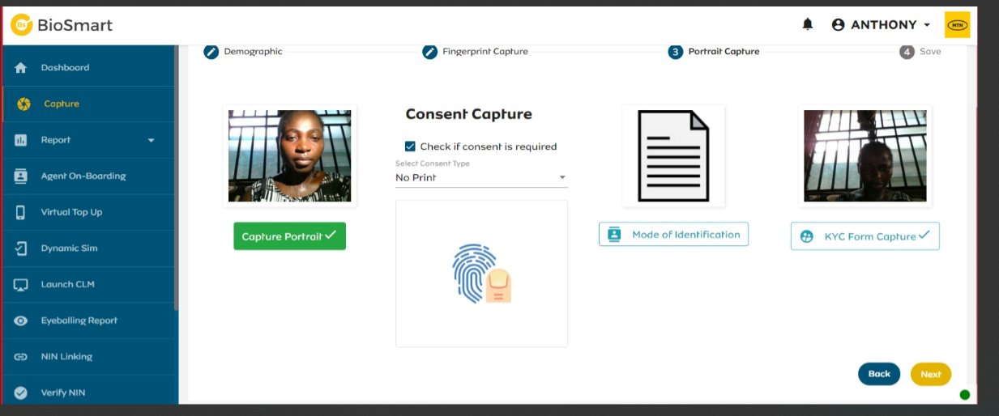

Slide 10
To Be Journey

Slide 11
User Stories
USE CASE ID | UC 1 FT _291
Use Case Name | Login into MTN Online portal/my mtn app to start sim related service and submit online
Description | To deploy a Digital platform (mtn online portal/mymtn app) where Customers can begin any SIM related service and visit the store to complete the transaction. System will generate a tracking ID for customer upon successfully filling the form which will be presented to an agent in-store. The customer will be able to initiate SIM Services:- SIM Swap MNP SIM Registration Customer shall sign, append fingerprint or capture image as signature . Generate tracking Ref ID on successful submission
Actors | Customers Agents MTN online portal My MTN app CLM Biosmart ESF Madapi
Assumptions | Existing login process should apply for customers to login Customers is able to fill in their details for SIM related services
Acceptance Criteria | For SIM Swap, (existing customer will have to log in to the portal using AS-IS log in process). For New Reg and MNP, the customer will not need to log in as they do not have their details on the system. They should be able to access this from the home page Select Service type : SIM Swap, SIM Registration, MNP On selecting request type (MNP / SIM Swap / SIM Reg), the system shall present the page for the customer to accept to Terms and Condition Where the customer accepts T&C, request, the system displays the applicable request form Where the customer do not accept T&C, the customer shall not be able to proceed to fill the request Customer name is auto-populated on the form and cannot be edited. This is applicable to existing customers requesting any SIM Related services (SIM Swap), the Customer Phone number is auto-populated on the form and cannot be edited. NB: For New Customer (MNP and New SIM Registration). Phone number is not auto-populated. There shall be an option to enter phone number to be re-registered. Details to be captured on form (Refer to attached form for MNP , SIM Swap and SIM Reg)

Slide 12
User Stories
USE CASE ID | UC 1 FT _291
Acceptance Criteria Cntd) | System present form to customer to fill Customer shall capture selfie as part of the form filling process. Selfie shall be captured directly from device camera and not uploaded via device memory Customer Submit Customer check the consent to update NIN details. Consent shall be applicable and distinct based on the request type selected. Consent for SIM Swap, SIM Reg and MNP below.. Consent content is configurable For SIM Swap “By providing your NIN, and requesting for SIM Swap, and filling this form, you are consenting to update our SIM Registration Records with your NIN details.” For SIM Reg “By providing your NIN, requesting for SIM Registration, and filling this form, you are consenting to update our SIM Registration Records with your NIN details.” For MNP By providing your NIN, requesting for SIM Registration / Mobile Number Porting, and filling this form, you are consenting to update your SIM Registration Records with your NIN details. ON successful submission, display in-app notification, "Refer to user story for notification" Where the customer attempts to submit without accepting consent display error and do not allow submission “You have a pending action to complete” T&C check box and Consent Check box shall be distinct. that is two separate box. The system shall have a Terms & Conditions for customer to check/accept before form submission is successful. T&C content is configurable. Where customer attempts to submit without checking the Terms and Condition box, display error and do not allow submission “You have a pending action to complete” Terms and Condition content for SIM Registration and SIM Swap shall include “I confirm that (i) all information provided is hereby correct and valid (ii) I have read, understand, and agree to be bound by the terms of the Privacy Noticed contained in www.mtnonline.com.” MTN Nigeria is authorized to use my information in accordance with the laws of the Federal Republic of Nigeria. Visit www.mtnonline.com for appropriate Terms and Conditions. Terms and Condition content for MNP shall include “I confirm that (i) all information provided is hereby correct and valid and I am appointing MTN Nigeria to close my account/number .................................. with the donor operator .............................. and port my number (ii) I have read, understand, and agree to be bound by the terms of the Privacy Notice contained in www.mtnonline.com”. Upon submission, the system generate a transaction ID and QR code. Transaction ID shall be Unique based on Service type: SIM Swap will have SWP0001, MNP- MNP001 and SIM Reg will have SREG0001 (Refer to user story for Transaction ID) The system shall trigger the request Reference ID and QR code to the customer’s email (if available), phone number and alternative number (on-net numbers) upon successful form "Refer to notification user story" NIN Validation shall happen in-store. it shall be possible to turn on and off validation. if turned on, it will happen online. if turned off, it happens in-store

Slide 13
User Stories
USE CASE ID | UC 1 FT _291
Acceptance Criteria Cntd) | ON successful submission, it shall be possible to present ability book an appointment via MTN Appointment Scheduler-Customer to see a URL to the MTN Appointment Scheduler. URL link to MTN Appointment schedule will be presented to customer (refer to notification user story) Customer shall be able to close appoint scheduler if they do not wish to book an appointment online Customer shall be able to fill form online using PDF (refer to PDF) Customer shall be able to print sim request details Customer can only have one active request type per phone number at a time. This means where the customer has successful submitted a request e.g. SIM Swap for phone number A and attempt to submit another SIM Swap request for the same number, the system shall display error Y’ello <customer name>, an active request exists for this number. Click here to view request details Customer shall be able to edit or cancel a submitted request. Customer shall be able to query Transaction ID and the system display options to Edit or Cancel submitted request (NB: Refer to notification table where request is modified) For SIM Swap form submitted online, the system shall have option to capture evalidator details (3 FDN, Activation Year and last recharge year) System shall validate the correctness of the swap question and display the “Validation Successful” or Validation Failed” notification to customer where questions are successfully validated or where validation fails respectively Where validation is successful, display in-app notification for successful submission and trigger notification to customer email and phone number Evalidator score shall be configurable. it shall be possible to set score at 15 to increase it to 50. Evalidator score for submit online shall be different for evalidator score for CLM. it shall be possible to set score per channel
Dependency | None

Slide 14
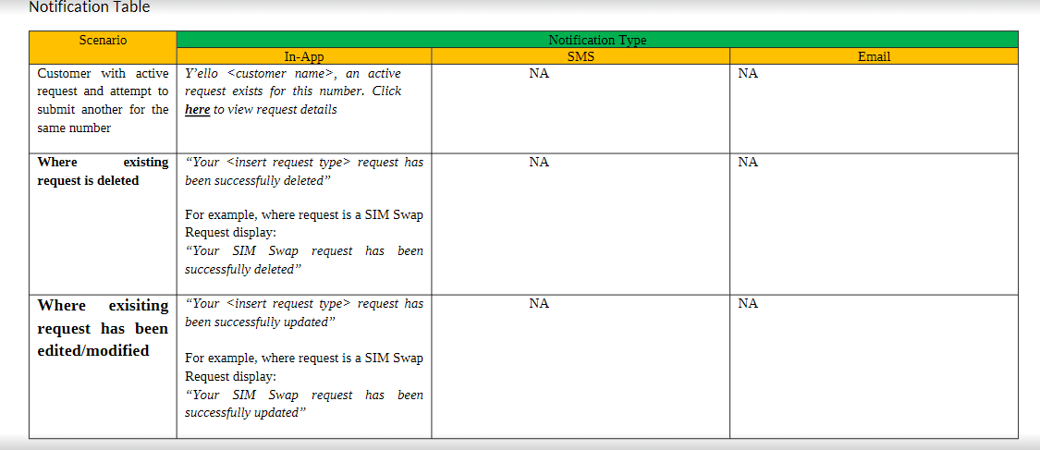

Slide 15
User Stories
USE CASE ID | UC 2 FT _292
Use Case Name | Transaction ID
Description | As a customer, I should be able to receive my transaction when I submit a SIM Related request online to improve customer experience
Actors | Customers Agents MTN online portal My MTN app CLM Biosmart ESF Madapi
Assumptions | Existing login process should apply for customers to login Customers should be able to fill in their details for SIM related issues
Acceptance Criteria | Transaction ID shall be a combination of alphanumeric characters with a hyphen separating the two part to increase readability. The Reference number shall follow the following format: First three (3) character shall be alphabets reflecting the service initiated. e.g. For MNP, first three letters with be MNP For SIM Swap, first 3 letters will be SWP For SIM Reg, first 3 letters will be REG Last five (5) shall be a combination of numbers eg xxxxx. Numbers shall be in ascending order to reflect the count for request made on that service. For example, where customer A fills a sim swap request, he receives Transaction ID as SWP00001 and where customer B, fills a sim swap request, he receives Reference number SWP0002 Sample Transaction ID Per Service type SIM Swap SWP00001 MNP MNP00001 REG REG000001

Slide 16
User Stories
USE CASE ID | UC 2 FT _292
Acceptance Criteria Cntd) | On submitting a request, the transaction ID for that request will be part of the notification displayed in-app Transaction ID must be unique. The system shall ensure that no request has similar transaction ID. This means each number generated will be unique for that customer/MSISDN request was made for. See Sample below MNP Request Successfully Submitted!!! Please check your email for details Reference ID: MNP-XXXXX Request valid till: Friday Sept.25, 2020. 5:00pm Transaction ID shall have an active duration of 72 hours (configurable) It shall be possible to user the Transaction ID or the customer phone number to autopopulate the details captured by the customer Where transaction is expired, and user attempt to query it, display notification Y’ello! Wallace, your request with Reference Number MNPxxxxxx has expired Please visit any MTN Service Centre to complete this request or visit www.mtnonline.com/request to initiate a new request. Thank you
Dependency | None

Slide 17
User Stories
USE CASE ID | UC 3 FT _293
Use Case Name | Notification
Description | As a customer, I want to receive notification when I submit my request online.
Actors | Customers Agents MTN online portal My MTN app CLM Biosmart ESF Madapi
Assumptions | Existing login process should apply for customers to login Customers should be able to fill in their details for SIM related issues Customers should be able to submit their SIM related issues successfully online Customers should have a Transaction reference ID
Acceptance Criteria | None
Dependency | None

Slide 18
User Stories
USE CASE ID | UC 4 FT _300
Use Case Name | Interactive Screen & Digital Signature
Description | As a user I want to be able to view my submission and append my signature digitally using a digital pen. This will improve the customer experience
Actors | Customers Agents MTN online portal My MTN app CLM Biosmart ESF Madapi
Assumptions | Existing login process should apply for customers to login Customers should be able to fill in their details for SIM related issues Customers should be able to submit their SIM related issues successfully online Customers should have a Transaction reference ID
Acceptance Criteria | Have a digital Pen and pad to append signature Customer shall be able to view their called-up information on the interactive screen, edit and update their pre-populated online form instore via the interactive screen The customer shall be able to sign on a digital pad or on the touchscreen with a stylus or fingerprint to complete the request at the agent's till Where Customers is submitting form online via MTN platform located at the shops, they should be able to append their signature system should be able to store filled form online storage
Dependency | None

Slide 19
User Stories
USE CASE ID | UC 5 FT _301
Use Case Name | QR Barcode Scanner
Description | As a user, I want to be able to scan the QR Barcode and have customer details populate on the system
Actors | Customers Agents MTN online portal My MTN app CLM Biosmart ESF Madapi
Assumptions | Existing login process should apply for customers to login Customers should be able to fill in their details for SIM related issues Customers should be able to submit their SIM related issues successfully online Customers should have a Transaction reference ID
Acceptance Criteria | Agent shall be able to scan QR code generated on successfully submitting request online On scanning the QR code, the system will populate the information on the system Where QR code is expired, display error message to customer that QR code is expired
Dependency | None

Slide 20
User Stories
USE CASE ID | UC 5 FT _301
Use Case Name | In-Store Completion
Description | As a user I want to complete my SIM Related process instore. this will improve AHT and wait time
Actors | Customers Agents MTN online portal My MTN app CLM Biosmart ESF Madapi
Assumptions | Existing login process should apply for customers to login Customers should be able to fill in their details for SIM related issues Customers should be able to submit their SIM related issues successfully online Customers should have a Transaction reference ID
Acceptance Criteria | SIM Swap Process Customer visit instore with Transaction ID, Phone number or QR Code Agent validate customer and perform NIN Validations / Verification Checks Agent log into the system CLM and select SIM Swap (NB Agent OTP for validation still apply) Agent enter Transaction ID/ Phone number / scan QR Code System validate that Transaction ID is still Valid Where Transaction ID is correct, auto-populate details capture and agent proceed to complete swap process and submit Swap is active after eyeballing NB: Max 4 eligibility checks, Live image capture, Same NIN checks, Consent on adopting NIN details, upload of swap document still apply
Dependency | None

Slide 21
User Stories
USE CASE ID | UC 5 FT _301
Acceptance Criteria | MNP Proces Instore Customer visit instore with Transaction ID, Phone number or QR Code Agent validate customer and perform NIN Validations / Verification Checks Agent log into the system and select MNP Agent enter Transaction ID/ Phone number / scan QR Code System validate that Transaction ID is still Valid Where Transaction ID is correct, System auto-populate details captured online Agent proceed to complete MNP process and submit MNP is active after successful processing and eyeballing NB: Sending Port to 3232, Max 4 checks, consent on adopting NIN details, upload of document still apply SIM Reg Instore Process Customer visit instore with Transaction ID, Phone number or QR Code Agent validate customer and perform NIN Validations / Verification Checks Agent log into the system and select SIM Reg Agent enter Transaction ID/ Phone number / scan QR Code System validate that Transaction ID is still Valid Where Transaction ID is correct, System auto-populate details captured online Agent proceed to complete SIM Reg (Capture Biometrice and Upload document where applicable) process and submit SIM Reg is active after successful processing and eyeballing NB: Max 4 checks, consent on adopting NIN details, upload of document still apply
Dependency | None

Slide 22
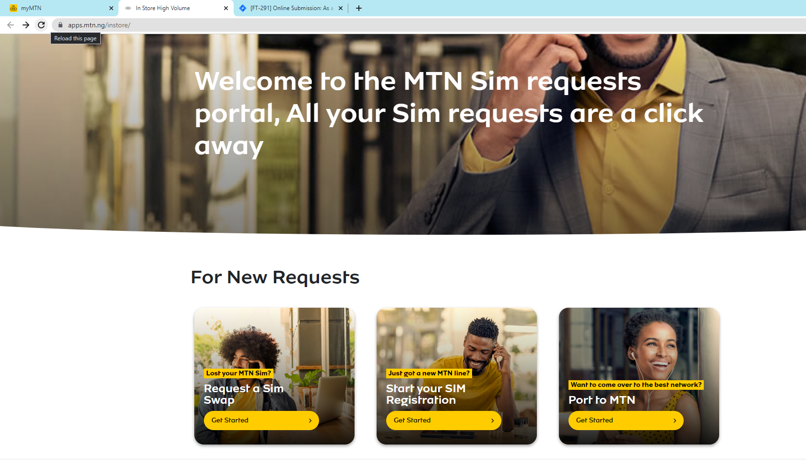
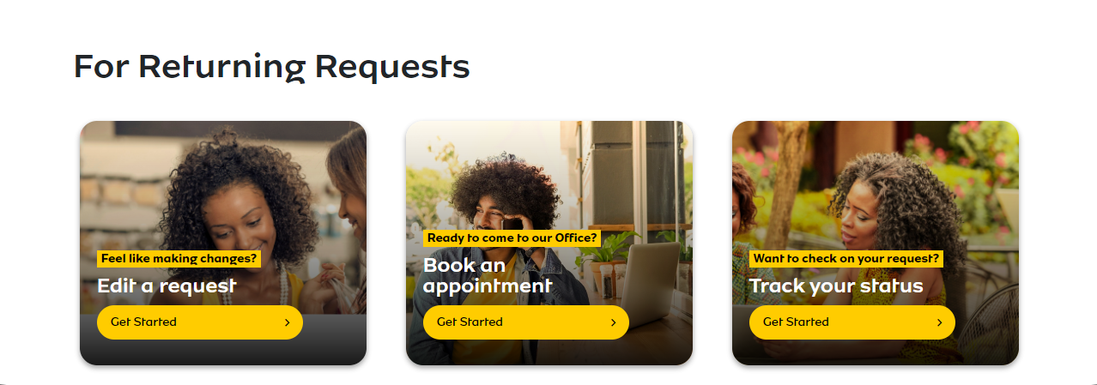
Log in Customer to start SIM related services via MTN online portal/my mtn app

Slide 23
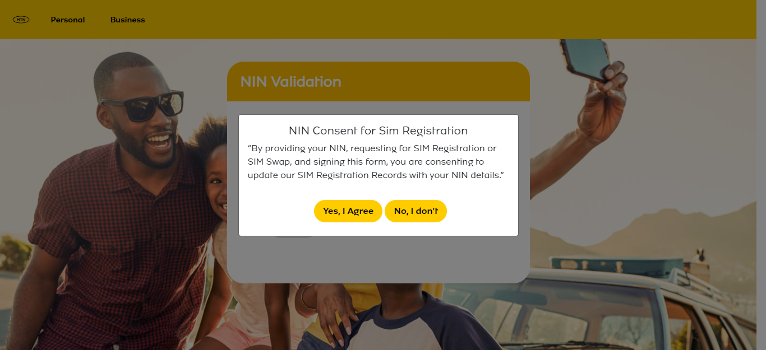
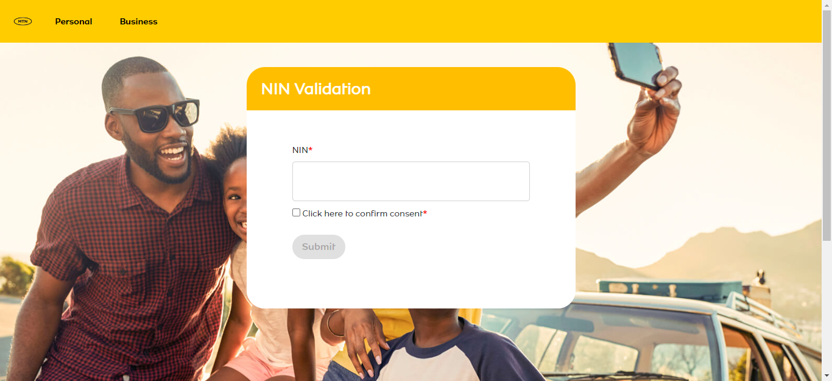

Slide 24
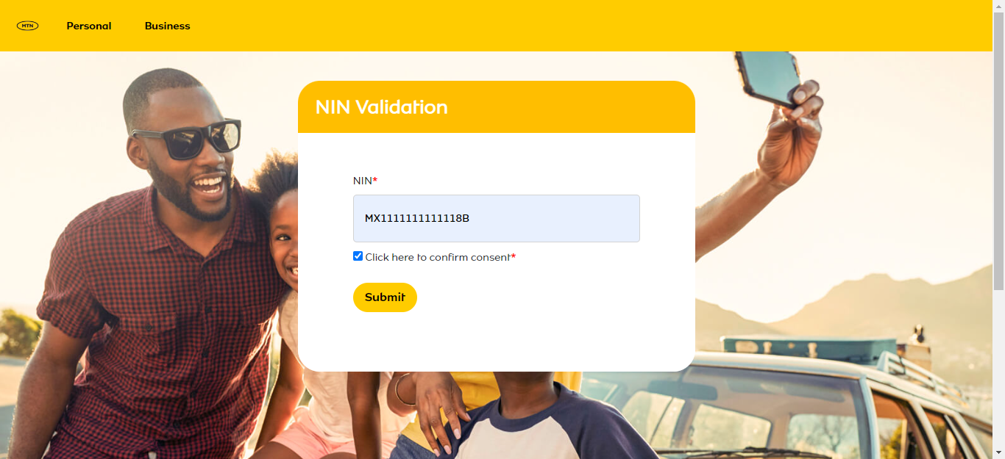

Slide 25
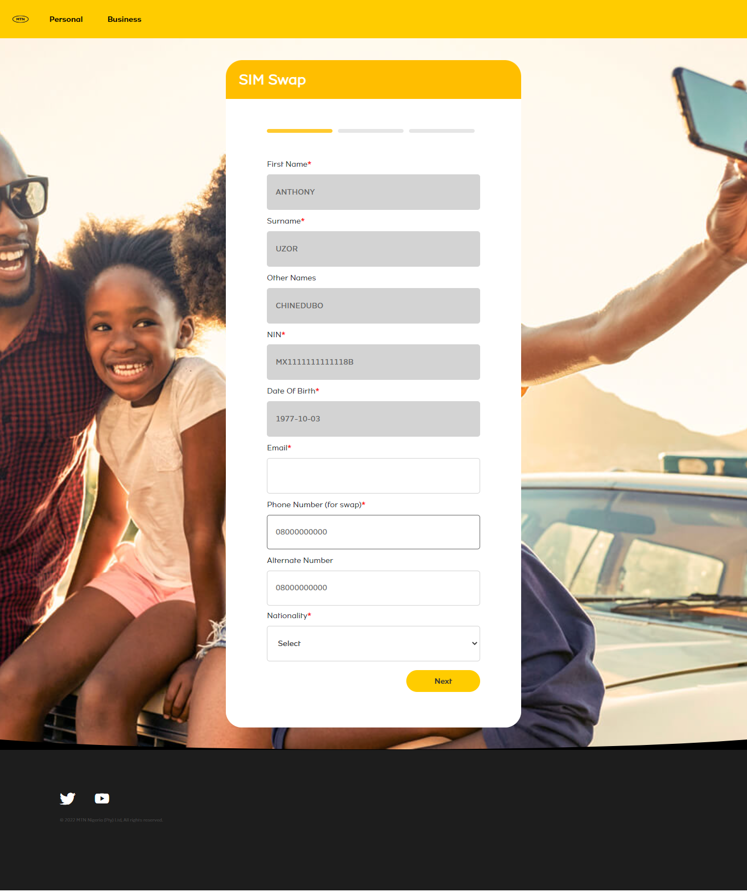

Slide 26
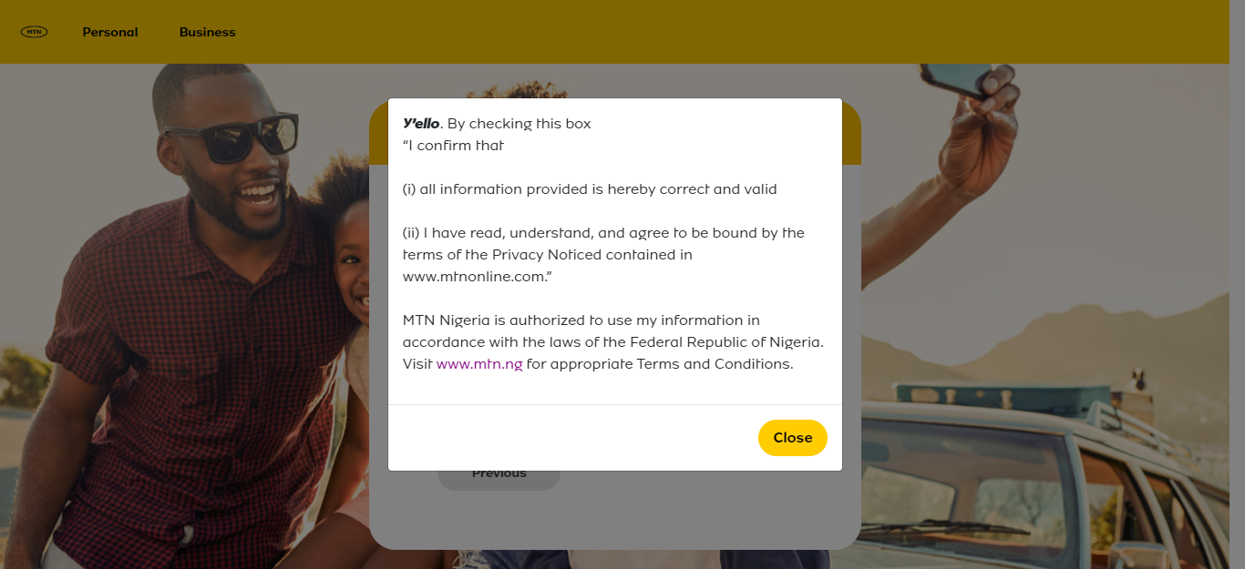
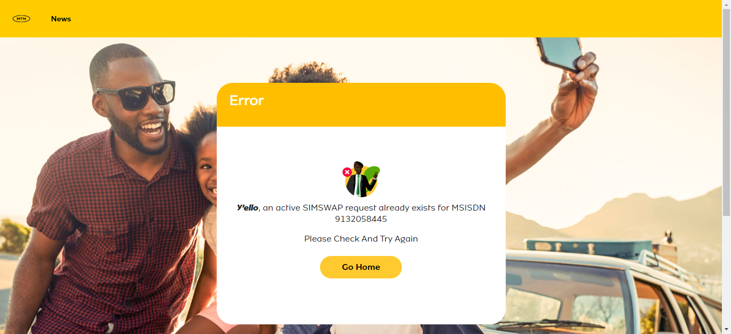

Slide 27
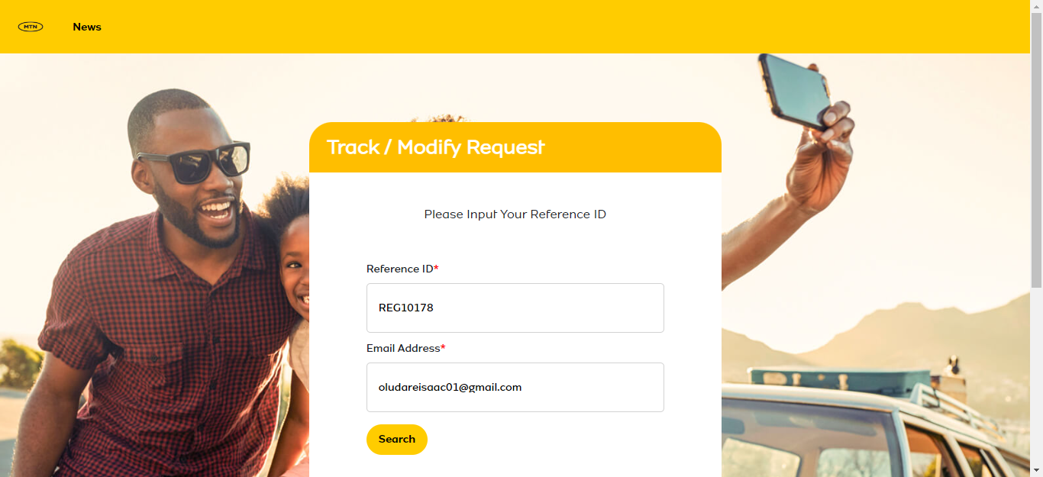
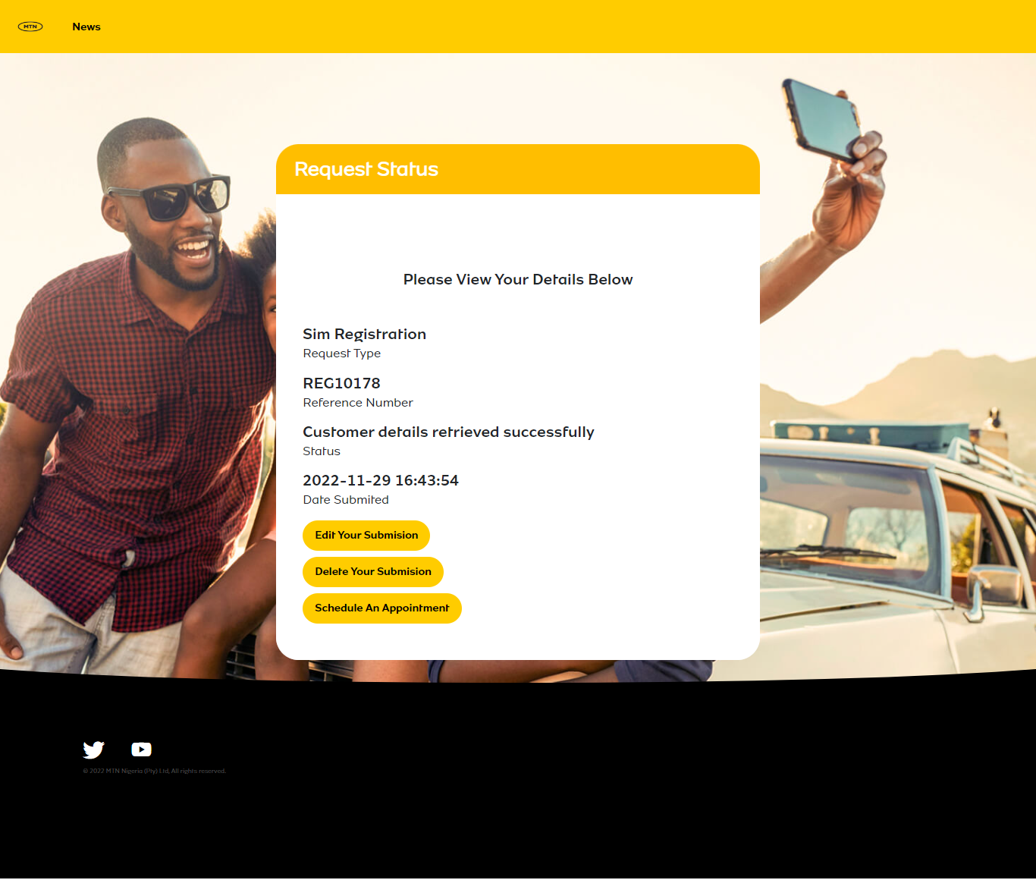

Slide 28
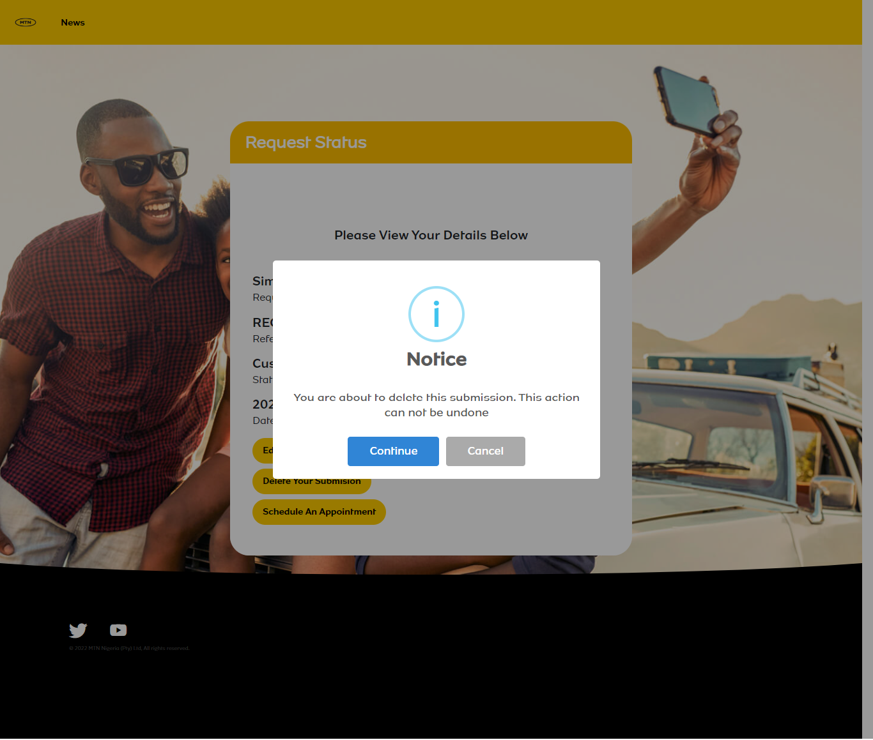
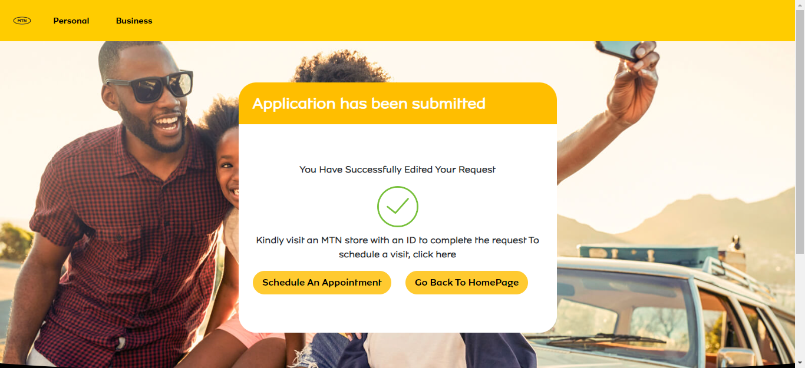

Slide 29
